Slide 1
CFS 스케줄러
국민대학교 임베디드 연구실
경 주 현
2017 LG MC 인재육성팀 교육

Slide 2
Outline
CFS scheduler
CFS Load balancer

Slide 3
Linux scheduler history
Linux 2.4: global queue, O(N)
Simple
Poor performance on multiprocessor/core
Poor performance when n is large
Linux 2.5: O(1) scheduler, per-CPU run queue
Solves performance problems in the old scheduler
Complex, error prone logic to boost interactivity

Slide 4
O(1)
The Linux scheduler was overhauled completely with the release of kernel 2.6
O(1) scheduler relies on active and expired arrays of processes
To achieve constant scheduling time
Problem

Slide 5
O(1)
The Linux scheduler was overhauled completely with the release of kernel 2.6
Time slice == nice value
To achieve constant scheduling time
Problem
No guarantee of fairness
the complex heuristics
interactive or non-interactive

Slide 6
Linux scheduler implementations
Linux 2.6~4.x: completely fair scheduler (CFS)
Fair
Naturally boosts interactivity
CFS scheduler defines a fixed time interval during which each thread in the system must run at least once.

Slide 7
Scheduler Policy
The key decisions made in the scheduler are :
“how to determine a thread’s timeslice? and how to pick the next thread to run”
Previous studies : FIFO, Round Robin
Problem : Starvation and unfair

Slide 8
On a single-CPU system
CFS is very simple.
An implementation of the weighted fair queueing(WFQ)
CFS scheduler defines a fixed time interval during which each thread in the system must run at least once.
The interval is divided among thread’s weights.
We call the time slice.
Time slice <- period / weight’s rate

Slide 9
“how to determine a thread’s timeslice? and how to pick the next thread to run”

Slide 10
CFS’s Time slice
Completely Fair Scheduler (CFS)
Provide each task CPU time proportional to its weight
time slice = (Weight of task / Total weight) x period

Slide 11
Task Weight
priority number must be mapped
kernel by a number between 100 and 139
A priority number of 120(nice value 0) = 1024 load
see prio_to_weight table
struct load_weight { unsigned long weight; }; // found in struct sched_entity
static const int prio_to_weight[40] = {
/* -20 */ 88761, 71755, 56483, 46273, 36291,
/* -15 */ 29154, 23254, 18705, 14949, 11916,
/* -10 */ 9548, 7620, 6100, 4904, 3906,
/* -5 */ 3121, 2501, 1991, 1586, 1277,
/* 0 */ 1024, 820, 655, 526, 423,
/* 5 */ 335, 272, 215, 172, 137,
/* 10 */ 110, 87, 70, 56, 45,
/* 15 */ 36, 29, 23, 18, 15,
};

Slide 12
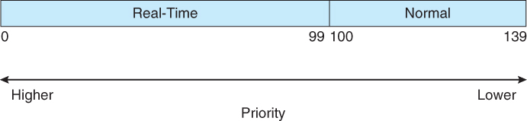
Nice Values and Task Priority
Non-real-time priority
Nice value (-20~19, default 0)
A large nice value corresponds to a lower priority
Real-time priority
Priority range: 0~99
Priority for real-time tasks
SCHED_FIFO, SCHED_RR
A smaller value corresponds to a higher priority
https://www2.cs.uic.edu/~jbell/CourseNotes/OperatingSystems/6_CPU_Scheduling.html

Slide 13
Task Weight Example
A priority: 120, normal task, load: 1024
A and B, running at a priority of 120
Available CPU time
1024 / (1024*2) = 0.5
Increased by one level to 121
820 ((1024/1.25))
Task A : 820/(1024+820)) = ~0.45
Task B : (1024/(1024+820)) = ~0.55
10% decrease in the CPU time share for Task A.

Slide 14
Time slice
se.load.weight
weight of scheduling entity
cfs_rq.load.weight
accumulation of weights of all tasks on its run queue
time_slice = (se.load.weight) / cfs_rq.load.weight) * sched_period();

Slide 15
sched_slice()
kernel/sched/fair.c

Slide 16
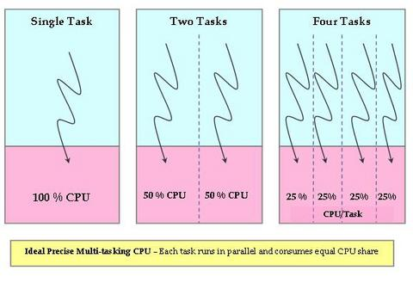
CFS problem
Real-world
CFS basically models an “ideal, precise multitasking CPU” on real hardware.”
But in real-world, ideal CPU is nonexistent.
Time-sharing system
http://www.linuxjournal.com/magazine/completely-fair-scheduler?page=0,0

Slide 17
CFS problem
Real-world
CFS basically models an “ideal, precise multitasking CPU” on real hardware.”
But in real-world, ideal CPU is nonexistent.
Solution
Virtual Runtime
http://www.linuxjournal.com/magazine/completely-fair-scheduler?page=0,0

Slide 18
vruntime
How long a process has run
vruntime +=
delta_exec * (NICE_0_LOAD / curr->load.weight);
delta_exec
The time spent by the task since the last time vruntime was updated.
CFS scheduler defines a fixed time interval during which each thread in the system must run at least once.

Slide 19
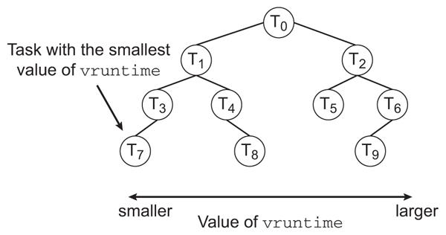
Red-black tree
Each runnable task is placed in a red-black tree
A balanced binary search tree whose key is based on the value of vruntime
The leftmost node has the smallest key value
the task with the highest priority
https://www2.cs.uic.edu/~jbell/CourseNotes/OperatingSystems/6_CPU_Scheduling.html

Slide 20
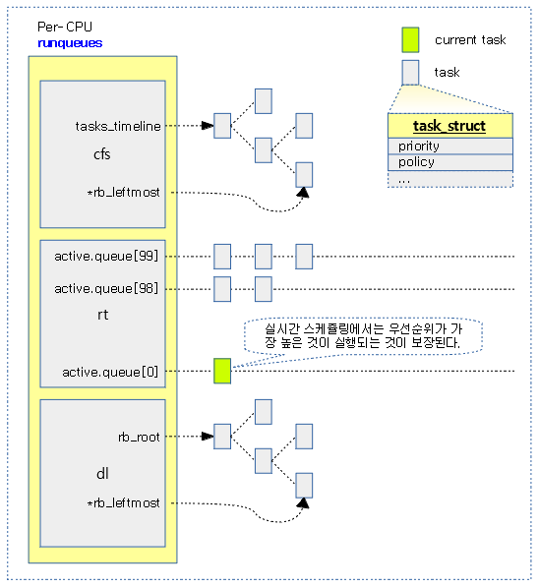
Red-black tree
http://jake.dothome.co.kr/

Slide 21
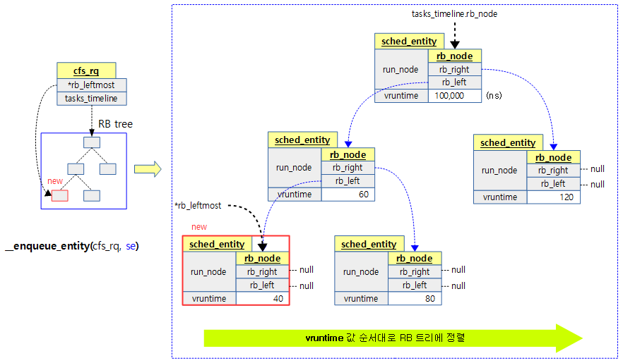
Red-black tree
http://jake.dothome.co.kr/

Slide 22
Linux multiplexing
Linux multiplexes by two situations.
Periodically forces a switch
Tick interrupt
Sleep and wakeup mechanism
process wait for device or pipe I/O

Slide 23
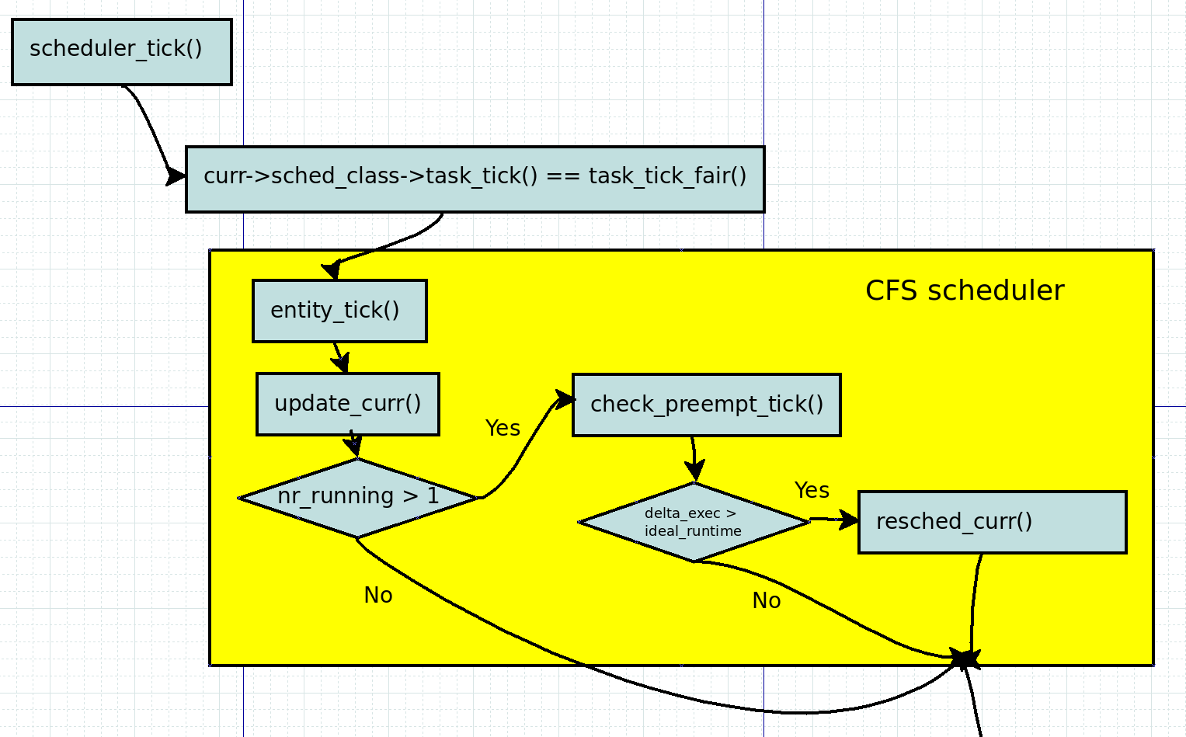
When schedule a task
Scheduler Tick

Slide 24
When schedule a task
Scheduler Tick

Slide 25
update_curr()
kernel/sched/fair.c

Slide 26
When schedule a task
Scheduler Tick

Slide 27
check_preempt_tick()
kernel/sched/fair.c

Slide 28
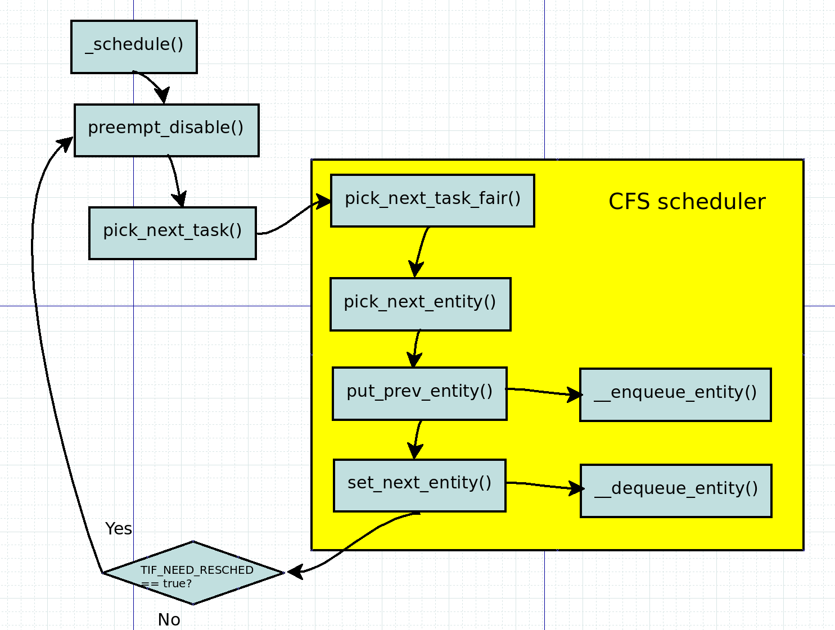
Scheduling by schedule()

Slide 29
Linux multiplexing
Linux multiplexes by two situations.
Periodically forces a switch
Tick interrupt
Sleep and wakeup mechanism
process wait for device or pipe I/O

Slide 30
“how to determine a thread’s timeslice? and how to pick the next thread to run”

Slide 31
Scheduling by schedule()

Slide 32
pick_next_task_fair()
kernel/sched/fair.c

Slide 33
Scheduling by schedule()

Slide 34
pick_next_entity()
kernel/sched/fair.c

Slide 35
Scheduling by schedule()

Slide 36
put_prev_entity()
kernel/sched/fair.c

Slide 37
Scheduling by schedule()

Slide 38
__enqueue_entity()
kernel/sched/fair.c

Slide 39
Scheduling by schedule()

Slide 40
set_next_entity()
kernel/sched/fair.c

Slide 41

Next Step.
Energy-aware scheduling: EAS
CFS scheduler - Kernel level
Load Balancer(Group Scheduling, Bandwidth Control, PELT)
EAS features

Slide 42
Reference
https://pdos.csail.mit.edu/6.828/2016/schedule.html
http://web.mit.edu/6.033
http://www.rdrop.com/~paulmck/
“Is Parallel Programming Hard, And If So, What Can You Do About It?”
Davidlohr Bueso. 2014. Scalability techniques for practical synchronization primitives. Commun. ACM 58
http://queue.acm.org/detail.cfm?id=2698990
"CPUFreq and The Scheduler Revolution in CPU Power Management", Rafael J. Wysocki
https://sites.google.com/site/embedwiki/oses/linux/pm/pm-qos
https://intl.aliyun.com/forum/read-916
User-level threads : co-routines
http://www.gamedevforever.com/291
https://www.youtube.com/watch?v=YYtzQ355_Co
Scheduler Activations
https://cgi.cse.unsw.edu.au/~cs3231/12s1/lectures/SchedulerActivations.pdf
https://en.wikipedia.org/wiki/FIFO_(computing_and_electronics)
http://jake.dothome.co.kr/
http://www.linuxjournal.com/magazine/completely-fair-scheduler?page=0,0
https://www2.cs.uic.edu/~jbell/CourseNotes/OperatingSystems/6_CPU_Scheduling.html
"Energy Aware Scheduling", Byungchul Park, LG Electronic
“Update on big.LITTLE scheduling experiments”, ARM
“EAS Update” 2015 september ARM
"EAS Overview and Integration Guide”, ARM TR
“Drowsy Power Management”, Matthew Lentz, SOSP 2015
https://www.slideshare.net/nanik/learning-aosp-android-hardware-abstraction-layer-hal
https://www.youtube.com/watch?v=oTGQXqD3CNI
https://www.youtube.com/watch?v=P80NcKUKpuo
https://lwn.net/Articles/398470/
“SCHED_DEADLINE: It’s Alive!”, ARM, 2017

